Slide 1
Anne Riley
Author and Developer of
The
Ideasphere Theory
Media Kit
https://www.thehumanidea.com | anne.riley.pgw@gmail.com

Slide 2
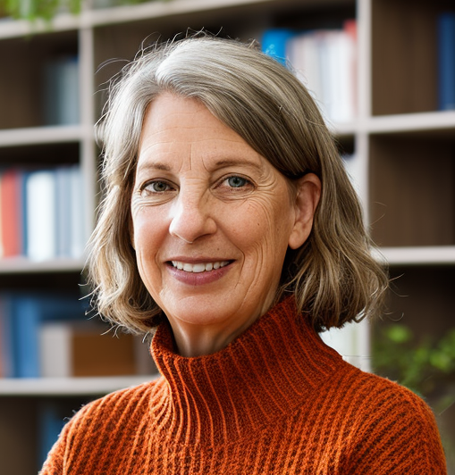
About Me
Anne Riley, born in Richland, Washington, is the eleventh of twelve children and grew up in Naperville, Illinois. She graduated from Illinois State University in 1981 with a degree in Accounting, earning the prestigious Bone Scholar award. She married her high school sweetheart , moved to the West Coast, and started a family. She earned an MBA from Portland State University. For many years, she balanced family life with a career in various industries, including technology, teaching, and finance, before retiring in 2011. Influenced by Michael Rothschild's Bionomics, Riley developed a theory known as the Ideasphere, exploring the parallels between human and ecological systems. Her theory is articulated in her novel DINA: Nature's Case for Democracy and a non-fiction book The Human Idea, Earth's Newest Ecosystem. Riley's writing, characterized by humor and depth, aims to engage and improve the lives of her readers.
Contact
https://www.thehumanidea.com/| anne.riley.pgw@gmail.com 1.503.313.9047
ANNE RILEY AUTHOR

Slide 3

Speech Topics
Earth’s Newest Ecosystem
Human Superpower: Choice
The Prime Directive
Education as Life Training
The One Job of Government
The Dance of the three C’s
Upending Equilibrium
The Future Depends On . . .
https://www.thehumanidea.com/| anne.riley.pgw@gmail.com 1.503.313.9047
ANNE RILEY AUTHOR

Slide 4
Speeches/Podcasts/Conversations
Date | Podcast Name | Link
1/7/25 | Andy's Personal Development Boadcast | https://youtube.com/live/nDqDCobAotY,
12/28/24 | One Voice Evolving | https://youtu.be/Cvn4j7l6uEQ?si=SrmGBjAttOmzbHde
12/15/24 | Junkyard Love Podcast | https://www.youtube.com/watch?v=xOsh-DCh6qU
12/12/24 | Not Enough Questions | https://www.youtube.com/watch?v=HUEww1UPI-4
11/20/24 | One Leg Up | https://bit.ly/3Cb7I6v
11/15/24 | Journey of My Mother's Son | https://bit.ly/4aqXj3l
11/9/24 | Politically High Tech | https://bit.ly/42hNeDM
11/7/24 | Coup Save America | https://bit.ly/4aifSGY
11/6/24 | One More Thing Before You Go | https://www.beforeyougopodcast.com/ideashere-rethinking-humanity/
10/29/24 | KAJ Masterclass | https://www.youtube.com/live/PQ0RGxX8eN0
10/14/24 | Raising Wild Hearts | https://apple.co/3UrjFLf
10/13/24 | ReConnect with Plant Wisdom | https://tigrillagardenia.com/reconnect-with-plant-wisdom-podcast/
9/8/24 | Coffee Time Again | https://bit.ly/3ZKvLmr
https://www.thehumanidea.com/| anne.riley.pgw@gmail.com 1.503.313.9047
ANNE RILEY AUTHOR

Slide 5

Social Statistics
1,040
6,930
LinkedIn Connections
@Anne Riley
BlueSky Followers
@anne-riley.bsky.social
656
10
Facebook Friends
@Anne Riley
Youtube Subscribers
@thehumanideasphere
52
24
Instagram - Public @anne_riley_ideasphere
Threads
anne_riley_ideasphere
https:/www.thehumanidea.com/| anne.riley.pgw@gmail.com 1.503.313.9047
ANNE RILEY AUTHOR

Slide 6
Let’s Discover Together
https://www.thehumanidea.com
https:/www.thehumanidea.com/| anne.riley.pgw@gmail.com 1.503.313.9047
THANK YOU

